Slide 1
Database Connectivity:
JDBC & MySQL

Slide 2
Communicating With a Database
JDBC code layer provided by MySQL database provider
Relational Database
e.g. MySQL
Our program
read / write data
Most major RDBMS providers supply JDBC code libraries to allow java developers to easily connect to their database.

Slide 3
Communicating With
Different Databases
JDBC Layer
MySQL
Our Application
Oracle
PostgresQL
  Each RDBMS has its own implementation of the JDBC Java Interfaces
    E.g. Each JDBC library must have a class implementing the PreparedStatement interface

Slide 4
Adding JDBC Drivers -
Including the Database’s Translator
  JDBC code libraries are referred to as JDBC drivers – jar files containing necessary classes
    E.g. mysql-connector-java-8.0.30.jar
  To use any database-related components in our code, we must include the appropriate driver in each project.
    Once the jar file is included in the project, the specific JDBC classes can be used by that project’s code
  To add a jar file to a project, we need to update the project’s POM file:
    Open pom.xml (contained in “Project Files”)
    Add the following below the <properties> tags
    <dependencies>
    <!-- https://mvnrepository.com/artifact/mysql/mysql-connector-java -->
    <dependency>
    <groupId>com.mysql</groupId>
    <artifactId>mysql-connector-j</artifactId>
    <version>9.3.0</version>
    </dependency>
    </dependencies>

Slide 5
Steps Required for
Database Communication
  Load the database driver
  Get a connection to the database
  Write the SQL query you wish to execute on the database
  Load the query into a statement and prepare it for execution
  Execute the query and get results
  Process the results – Either loop through the results retrieved or deal with the single result returned
  Close everything you opened, i.e.:
    The object to hold the results
    The statement used to run SQL
    The connection used to interact with the database
Set up for database interaction
Specific interaction with database

Slide 6
Database Communication in Code:
Step 1) Driver Inclusion
  Before we try to work with a database, we need to speak its language
    If you do not have the driver added to the project’s library (i.e. the POM file), then programs will not work correctly when the code is run.
  To do this, we need to load up the database’s driver
    I.e. Load the code from an external provider that allows us to communicate with the database
  In code:
    Class.forName("com.mysql.cj.jdbc.Driver");
  This name DOES NOT CHANGE and is CASE-SENSITIVE. When you use the mysql driver, it is always called com.mysql.cj.jdbc.Driver, no matter what your driver file’s name actually is.
    Why?

Slide 7
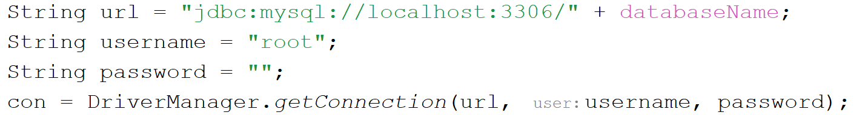
Database Communication in Code:
Step 2) Connect to the Database
  Just like working with a database via command line, the program needs a connection to the database to interact over.
  We connect to a database via a specific URL and supply the username & password to access that database
  Making a connection:
URL to the database server

Slide 8
Understanding the Database URL
  Final URL:
    jdbc:mysql://localhost:3306/test
  The URL is broken into :
    Protocol to be used and database type being accessed
      “jdbc:mysql://” (“jdbc” is always used)
    IP where the database server is running and port it’s listening on – Together : localhost:3306/
      IP is localhost where the server is on the same computer as your code)
      Port is 3306 (default port of MySQL)
    Name of the database you’re connecting to. In this example the database is called “test”

Slide 9
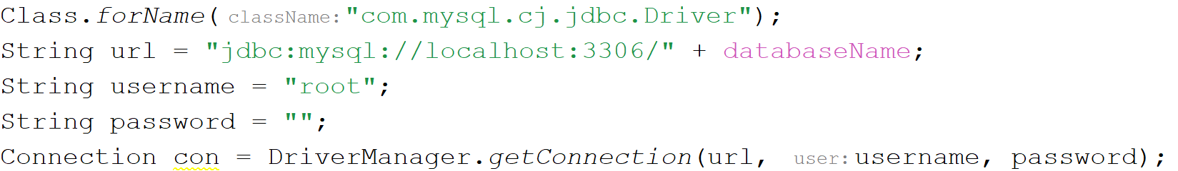
Database Communication in Code:
Summary of Set-Up Stage

Slide 10
DB Communication in Code:
Step 3) Write the SQL & store it in a variable
  At this stage, we have access to the database, now we can run any SQL we want.
  Before we run SQL, we store it in a variable (a String)
    Where we want to include variable values, we put in a ?
  In code:
    String query = “SELECT * from users WHERE username = ? AND password = ?”
  The ? is a placeholder marking where we’re going to fill in a variable value
    We never concatenate (add variables into the String directly) due to security risks

Slide 11
DB Communication in Code:
Step 4a) Create a PreparedStatement
  SQL cannot execute as a String, we need to convert it into something the database understands – a PreparedStatement
    To make a PreparedStatement, we ask our Connection object to prepare an object for the specific SQL query
    This PreparedStatement object is used to execute a given SQL statement (hence the name) – without this no SQL can be run.
  In code:
    PreparedStatement stmt = conn.prepareStatement(query);

Slide 12
DB Communication in Code:
Step 4b) Fill in the blanks within the query
  Before we use our prepared statement, we need to fill in the blanks (IF we had blanks. SQL statements without variables/placeholders don’t need this)
    The ?s we left in the query String need to get actual values
  In code:
    // Fill in the blanks/?s
    ps.setString(1, usernameVariable);
    ps.setString(2, passwordVariable);
  Note 1: Unlike arrays, the ? index starts at 1.
    First ? is position 1, second ? is position 2 etc.
  Note 2: We use different methods to set different TYPES of info:
    setString()
    setInt()
    setDouble()
    Etc…
Note:
This step doesn’t always happen!

Slide 13
Placeholders in SQL - The ? Notation
  ? is used to mark where we will insert a variable
    Avoids concatenating/inserting variable contents directly – this addresses SQL injection
  We fill in the spaces left by ?s after the statement is prepared by the database connection
    The SQL statement code is then locked and all other components are treated as text/numbers etc instead of code
  When filling in the spaces, use whatever method matches the type of information being inserted
    E.g. setInt() for ints, setDouble() for doubles, setString() for Strings etc.
  Each ? has its own index
    First ? that appears is at index 1, second ? is at index 2 etc.
  Example query:
    “Select * from Product where cost > ? and name LIKE ?”
  Filling in those blanks:
    ps.setDouble(1, startingCostPrice);
    ps.setString(2, “%”+name+”%”);
When using LIKE in SQL, insert wildcards when setting the String in the ? slot

Slide 14
DB Communication in Code:
Step 5) Execute the SQL
  Once the SQL has been fully built, we need to execute it in the database and get results
    This will always result in some sort of result info
  In code:
    ResultSet rs = ps.executeQuery();
    Used to run select statements
    Returns the set of all results for this select query
    OR
    int numRowsChanged = ps.executeUpdate();
    Used to run update, insert and delete statements
    Results the number of rows changed by this query
    This should never be used on select queries, it will cause an exception!
Notes:
executeUpdate can also be used on inserts and deletes, as well as to amend table structures using SQL DDL (Data Definition Language) but is primarily used for updates. It should never be used on anything that may produce a result as this would cause an exception.

Slide 15
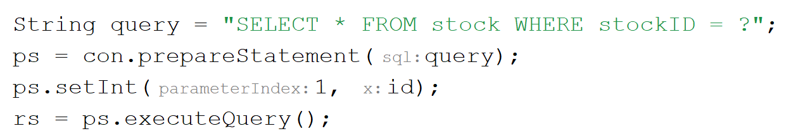
Database Communication in Code:
Summary of Execution Stage

Slide 16
Dealing With Results
  Results come in 3 forms:
    Single row resultset – occurs where selecting based on the primary key of a table, or when the combination of criteria should result in only one result
    Multi-row resultset – the result of a more general select
    A number – how many rows/entries in the database were changed by the executed update/insert/delete
  We handle each of these differently
    No extra processing needed for 3, just use the number
    1 and 2 require extra (very similar) steps

Slide 17
What to Do with ResultSet Data:
Modelling Your Database in Code
  Data is stored in databases
    Designed for the task
    Easy to search
    Easy to manipulate
  Data needs to get from database to code so we can work with it
    Databases store data in tables
    Code stores data in objects (Java does, anyway)
  Tables and objects are structured differently
    Need a bridge to get from A to B – Data Transfer Objects.

Slide 18
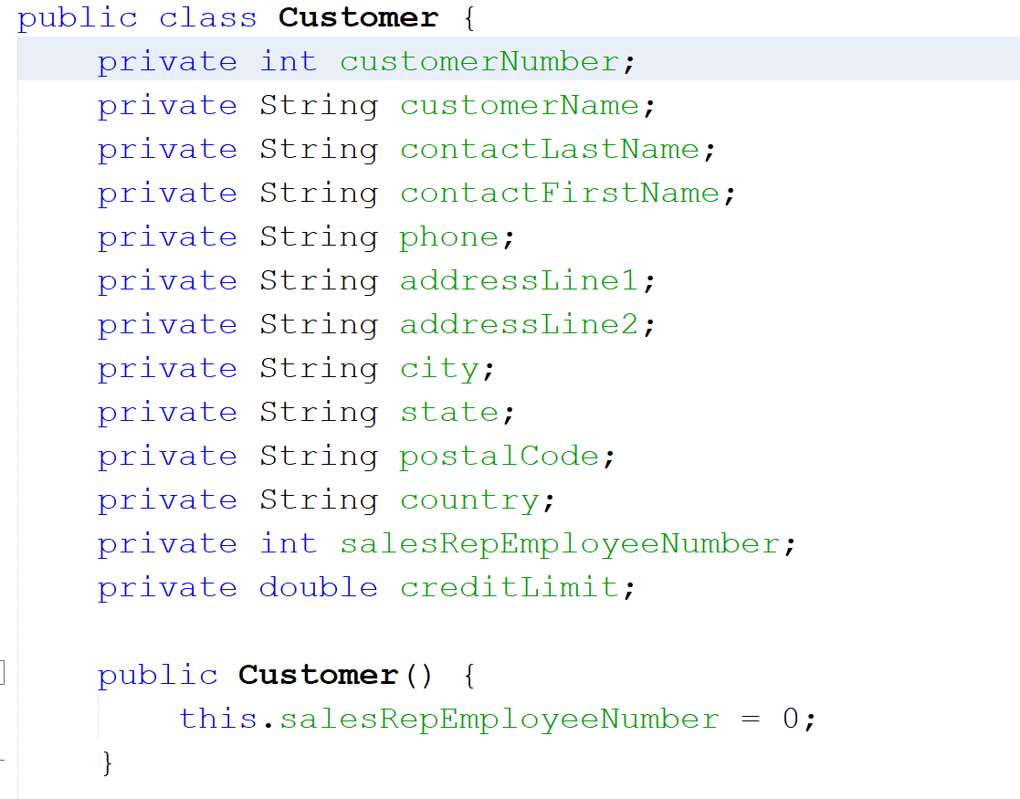
Modelling Your Database in Code: Building Data Transfer Objects
We can write a class that encapsulates the fields that exist in the database table
This gives us a mapping from our code to the database – an “object to relational database mapping” (ORM)
We can call instances of this class transfer objects because we can use them to carry data about customers around our code

Slide 19
DB Communication in Code:
Step 6) Process the Results – Single Result
  To deal with a single result, we:
    Load the first row of the resultset
    Access each component and store in a variable
  In code:
  //Load the first result (if there is one) – without this there will be no results to read!
  if(rs.next()){
  // Access each component & store in a variable
  int id = rs.getInt(“userId”);
  String fName = rs.getString(“firstName”);
  String lName = rs.getString(“lastName”);
  // Use the components to build a DTO
  User u = new User(id, username, password, fName, lName);
  }
  When retrieving result components, there are different methods to retrieve different types of data.
    getString(), getBoolean(), getInt(), getDouble(), getTimestamp() etc
Retrieve the component by specifying its column name

Slide 20
DB Communication in Code:
Step 6) Process the Results – Multiple Results
  To deal with multiple results, we:
    Repeatedly load the next row of the resultset – use a while loop to load to the end
    Access each component and store in a variable
  In code:
    //Load the next result (if there is one)
    while(rs.next()){
    // Access each component & store in a variable
    int id = rs.getInt(“userId”);
    String fName = rs.getString(“firstName”);
    String lName = rs.getString(“lastName”);
    // Use the components to build a DTO
    User u = new User(id, username, password, fName, lName);
    }
Only change is to go from if to while!
Note: You shouldn’t get multiple results when selecting based on a username and password. Why?

Slide 21
DB Communication in Code:
Step 7) Close Your Resources
  As with file handling and network communication, you should close everything you open!
    If not, you are wasting system resources
  When closing up database resources, you should close (in this order):
    The ResultSet storing results from the database (if there is one)
    The PreparedStatement you used to run SQL on the database
    The Connection you used to access the database
  This closing process should always happen, whether the database query successfully completed or not
  This process should be done in reverse order of opening
    Whatever was opened last should be closed first and so on
  In code: Avoid the issue – use try-with-resources!

Slide 22
What About Exceptions?
  Where could exceptions occur? What could go wrong??
  Load the database driver
  Get a connection to the database
  Write the SQL query you wish to execute on the database
  Load the query into a statement and prepare it for execution
  Execute the query and get results
  Process the results – Either loop through the results retrieved or deal with the single result returned
  Close everything you opened, i.e.:
    The object to hold the results
    The statement used to run SQL
    The connection used to interact with the database

Slide 23
Possible Issue Points:
1) The Setup Stage
  Loading the driver can cause a ClassNotFoundException
    Cause: No Driver files found matching that name
  Getting a Connection can cause an SQLException
    Common possible causes include:
      Database server is not turned on in that location
      That specific database is not available on the server
      The credentials (username & password) are invalid
      Many others!

Slide 24
Possible Issue Points:
2) The Query Execution Stage
  Preparing the statement can cause an SQLException
    Possible causes:
      Connection wasn’t established cleanly
      The connection has already been closed
  Executing the query can cause an SQLException
    Possible causes:
      The prepared statement/underlying connection has been closed
      The database server has been switched off
      You are using executeQuery with SQL that doesn’t select anything

Slide 25
Possible Issue Points:
3) The Result Processing Stage
  Calling .next() on the resultset can cause an SQLException
    Possible causes:
      The underlying connection was closed
      The resultset has been closed
  Getting a row’s component from the resultset using nextInt/nextString/ nextDouble etc can cause an SQLException
    Possible causes:
      Using the wrong method for the type stored in that table field (eg nextInt where varchars is stored)
      Using the wrong field name as a parameter
      The resultset has been closed already

Slide 26
Code Example
Check out IntroSQLExample.java in the databases.A_introToJdbc package
(SlideExamples repository)

